Slide 1
E-LAR , an Edu AR Application
DEPARTMENT OF COMPUTER Engineering
Government polytechnic ,pune
Head of department Guided by Developed by
U. v. Kokate A. s. Paike Anirudha kurhade
Gaurav lonari
Nisarg navale
Piyushka deshmukh

Slide 2
Problem Statement
To Counter And Solve Live Demonstration Of Experiment Related Issues In Online Teaching In Various Educational Sectors

Slide 3
Solution
We noted down the problem statement and its various aspects and we came with a solution “E-LAR, an Educational Augmented Reality Application ”.
What is E-LAR about ?
E-LAR is nothing but Augmented Reality Application which transforms 2 Dimensional into 3 Dimensional Animated Model.
It uses various AR related components and concepts to create a real time dynamic user convenient 3 Dimensional Object

Slide 4
What is AR & How AR works ?
AR is a augmented reality . It is a combination of real world and computer generated data
Augmented Reality works through a webcam and relayed through the screen
Augment, allow users to place life-size 3D models in your environment with or without the use of trackers. Trackers are simple images that 3D models can be attached to in Augmented Reality.

Slide 5
Project Plan & Requirement Specification
9 th April 2021 :- Finalized Project Problem Statement.
1 st Week :- Requirement Gathering , Scope Analysing And Project Plan
2 nd Week :- Software and Other Project Requirement Installation And Project Design Finalization And Module Divisions
3 rd Week :- Design Module 1 i.e GUI for Application.
4 th Week – 6 th Week :- Testing The GUI And Making The AR Module And 3 d Models.
7 th Week :- Integration Of Various modules into Single Application
8 th Week :- Testing And Other Documentational Work .
9 th Week :- Presentation Of The Product

Slide 6





Platforms Used
Unity
Vuforia
Blender
Adobe Fuse with Maximo

Slide 7
Lets see practical implementation

Slide 8
Pillar Concepts Of ELAR
AR Camera
Directional Lights
Plane Finder
Event System
Ground Plane Stage
Image Target
Animation Controller

Slide 9
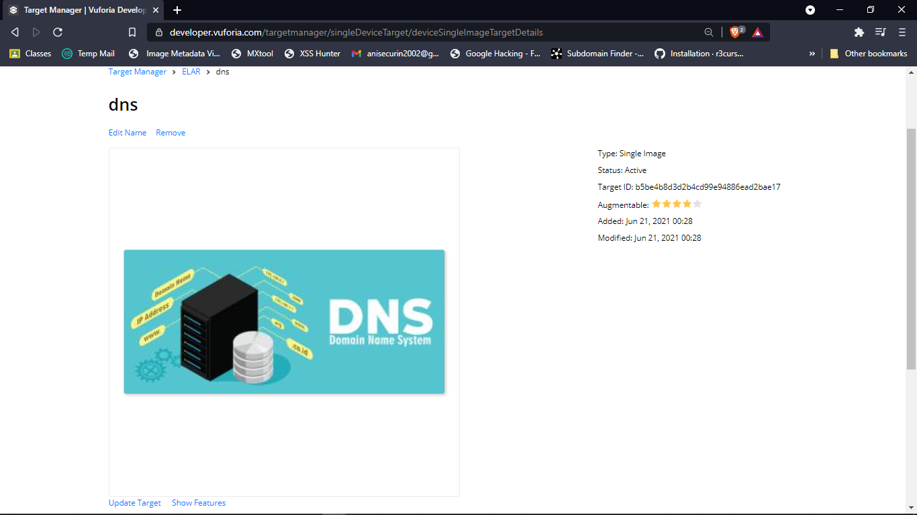
Going Through The Core Working

Slide 10
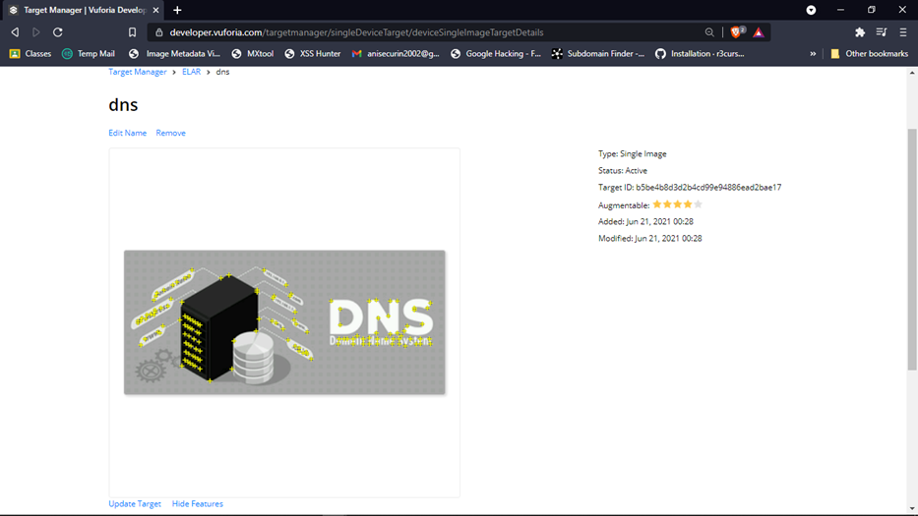

Slide 11
Project Testing
Functional Testing
Images And Models creation And Handling.
Unit Testing
Layouts And Landing Screen .
Overall Cost Estimation
Total Development Cost And Budget.
Future Maintenance And Upgradation Cost.

Slide 12
Advantages Of Using E-LAR
The AR system is highly interactive in nature and operates simultaneously with real time environment.
It reduces line between real world and virtual world.
It enhances perceptions and interactions with the real world.
It can be applied to part of practical’s as it makes things memorable and eye catching.

Slide 13
Flaws of E-LAR
Technical Failure :Technical failures like camera not working, damaged screen or Low battery of mobile phone may cause trouble while using the application.
Large Application Size :- Due To Large Images Size The Application Became Heavier And Runs A With Less Efficiency. This Can Be Overcome By Using Servers.
Static Image Models Only :- 3D Models Or View Is Only Created For Those Images Which Have Statically Assigned Models.

Slide 14
Future Scopes
Improvement can be done for authorizing the modification properties to other users as well.
The detailed internal structures of the objects can be added for efficient studying.
The application size can be reduced.
Tracking can be included as a part of the application – which object was viewed previously can be notified.
The various parts of the object can be efficiently labeled.
Instead of rotating the camera in different angles , animation videos can be prefered .

Slide 15
What We Have Studied ?
Development of real time Augmented Reality Application.
Development of 3D models.
Going through various project development Phases.
Tackling and Solving situational development problems.
Actual team work and work ethics.
Proper Professional level pitching of products.

Slide 16
A Humble Gratitude
We would like to pay a humble gratitude to Mrs. Paike Mam for guiding and mentoring of the right path for achieving this final product. we always would be thankful to her for providing us the opportunity and strengthening our idea We learn something new from you every day. Thank you for providing Us such a strong foundation in an industry that can be confusing.
Thank You!!
Anirudh Kurhade(1806030)
Gaurav Lonari(1806032)
Nisarg Navale(1806037)
Piyushka Deshmukh(1806061)

